Slide 1


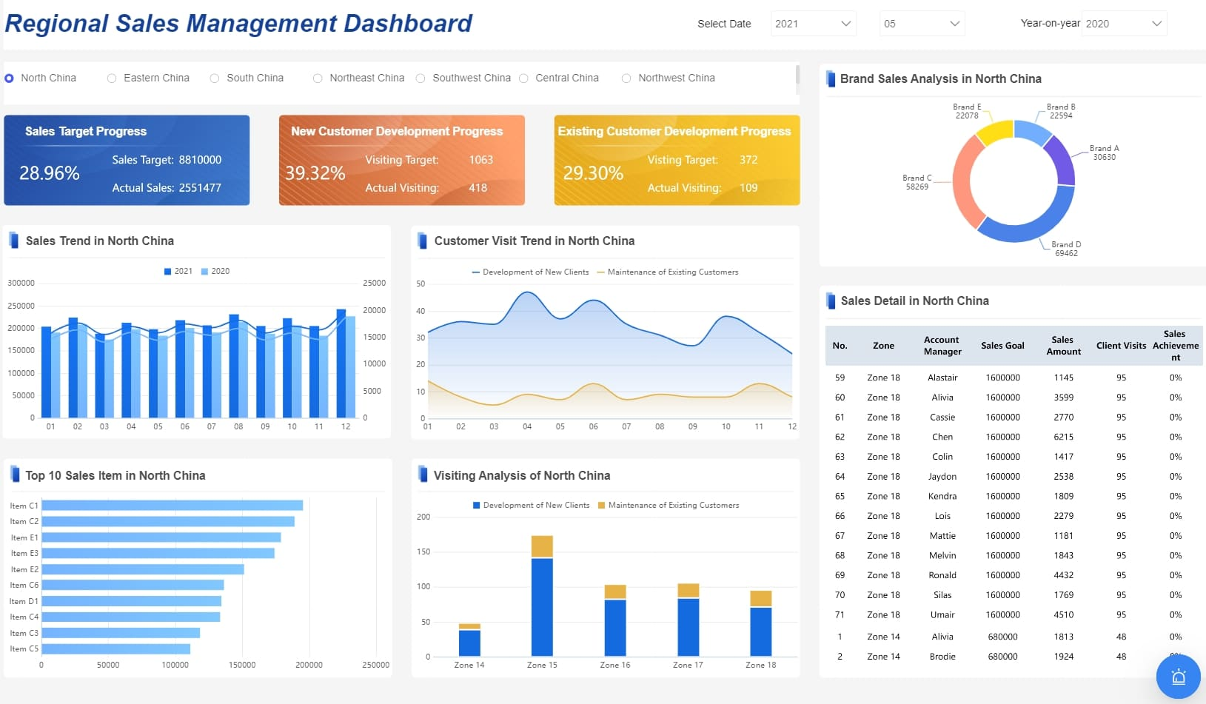

Sales Report Automation
SUSAN MASUNGA
TATENDA CHIKOPFA
HLEI NAI
25BCA10360
25BCA10438
25BCA10399
25BCA-2B
OFFICE AUTOMATION
CHANDIGARH UNIVERSITY

Slide 2
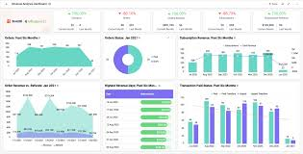
What is Sales Report Automation
Sales Report Automation uses software to collect, process, and generate sales data automation. It saves time, reduces manual errors, and provides real-time insights.

Slide 3
Sales Report Automation
In any business sales data plays a crucial role in decision making. Traditionally preparing sales reports is a manual and time-consuming task involving data collection, sorting and analysis. Sales Report Automation simplifies this process by automatically generating accurate, up to date reports from sales data.
This project focuses on developing a system that can collect, analyze, and present sales information automatically, saving time, reducing errors, and improving management efficiency.

Slide 4
Tools and Technologies Used
Microsoft Excel (VBA Macros)
Power BI/Tableau
SQL Database
Python/R
Email Automation

Slide 5

What is Sales Report Automation?
The process of using software tools to automatically:
Collect data from multiple sources, process and clean the data
Generates reports and dashboards

Slide 6
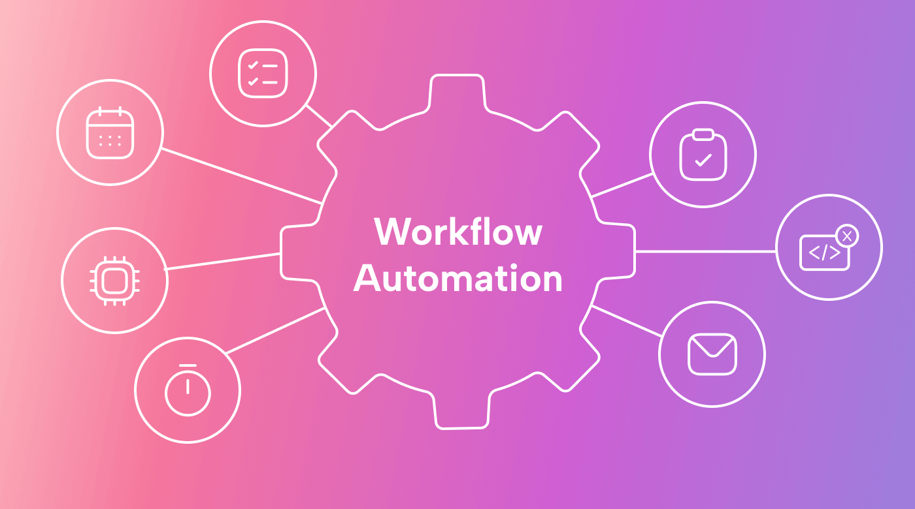
The Automated Workflow
1. DATA COLLECTION
CRM Systems
Excel Files
Database Sources
2. DATA PROCESSING
Automated Cleaning
Transformation
Validation

Slide 7
The Automated Workflow
3. REPORT GENERATION
Scheduled Reports
Real-time Dashboards
4. DISTRIBUTION
Email Alerts
Shared Dashboards
Mobile Access

Slide 8


The challenges of Manual Reporting
6-8 hours weekly spent on manual data entry
15% error rate in manual calculation, humans can make a small error on calculating and it changes everything
2-3 days in report generation
Limited time for actual analysis

Slide 9
Key benefits and impact of Sale Report Automaton
Time Saving – Automation handles repetitive tasks, reducing report generation time significantly
Accuracy – Eliminates manual errors, data is 99.9% accuracy. It minimizes manual human errors in sales data processing, ensuring reliable insights.
Provides up-to-date data for informed decision making and lets sales teams focus on strategy and customer relationships.
To store and manage sales records efficiently and provides quick access to updated intimation

Slide 10

The Automated Workflow/System Design
Data Collection(fetch data from sources)
Process and clean data
Generate formatted reports
Update dashboards
Auto-share via Email

Slide 11
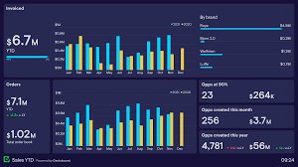
How Sales Report Automation Makes Business Easy
Saves Massive Time, fewer mistakes, always updated, fast decisions, better planning and saves money
Example
Small shop owner
Before: Spent Sundays calculating weekly sales
After: Gets automatic report every Monday morning
Result: See their performance and has more time as they know exactly what to order.

Slide 12

Conclusion
Sales Report Automation streamlines business reporting. It supports data driven decisions, enhances efficiency, and is a core part of digital office transformation. By selecting appropriate tools and addressing implementation considerations, businesses can enhance their sales reporting process

Slide 13
References & Acknowledgement
Refrences
Microsoft Power Bi Docs
Tableau Public
Acknowledgement
Thanks to Chandigarh University

Slide 14
THANK YOU

